Slide 1
CompE571: Project Progress Report Bot Sensing System
Daniel Foster
Vahe Ohanian
November 1st, 2017

Slide 2
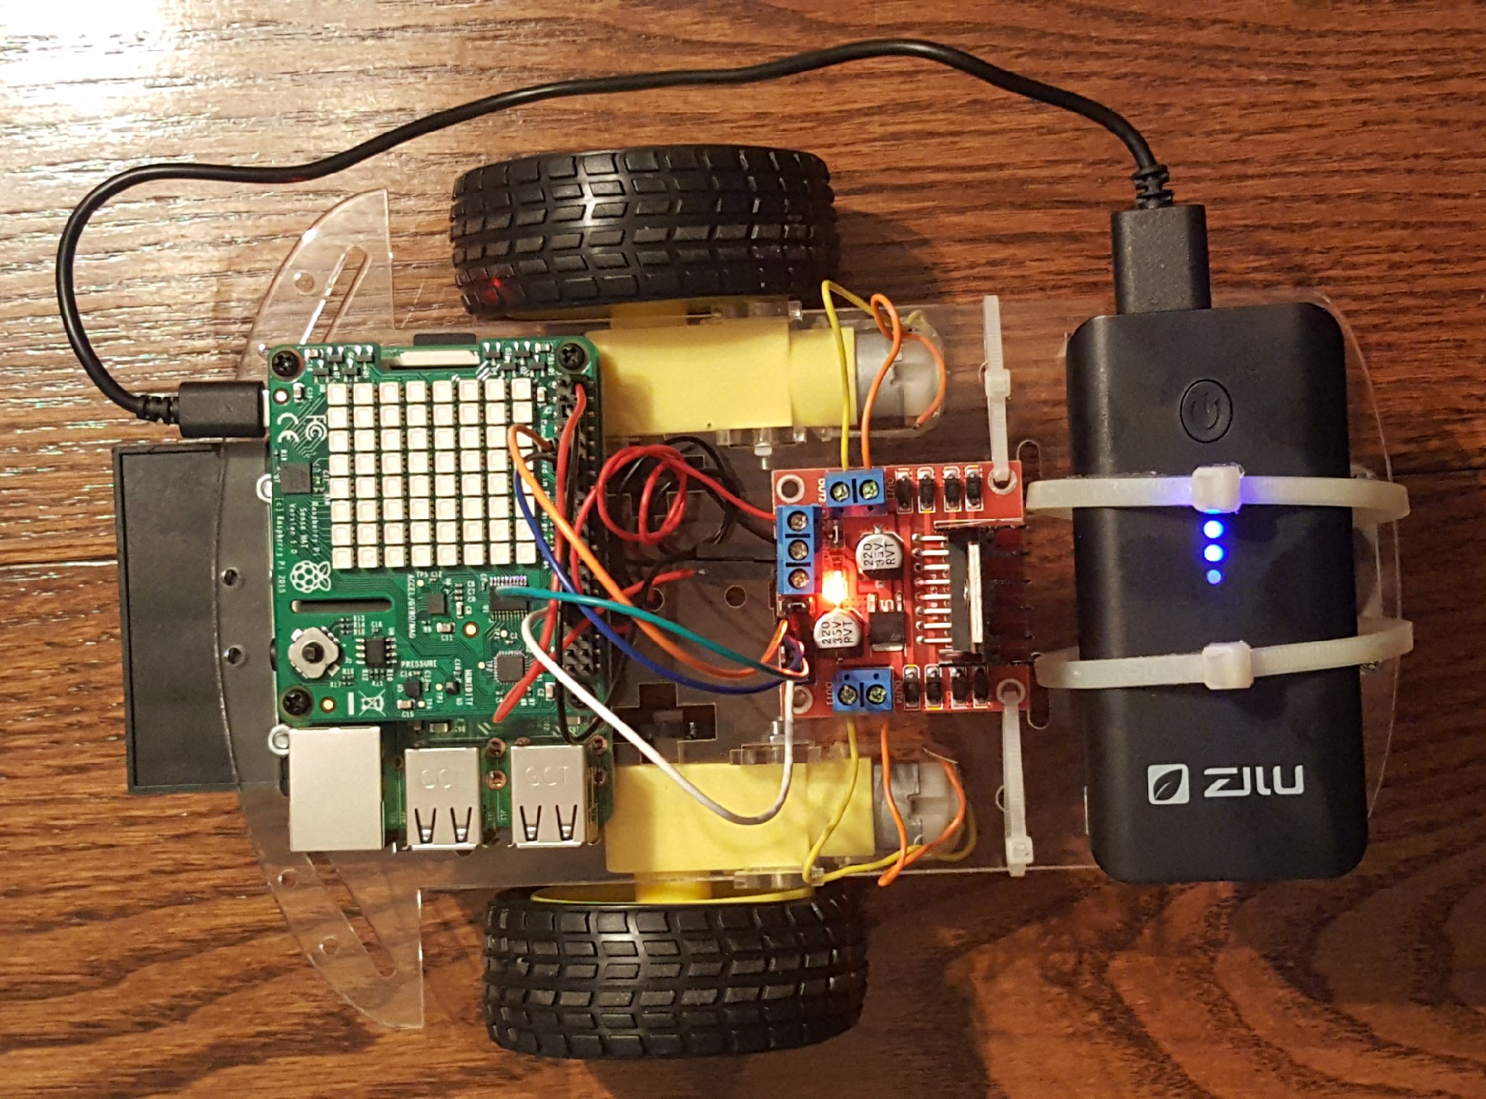
Description
Small bot environment sensing
Raspberry Pi/Sense Hat
Raspbian Jessie (Debian based, like UNIX, but not RTOS)
Kernel modules on RPi

Slide 3
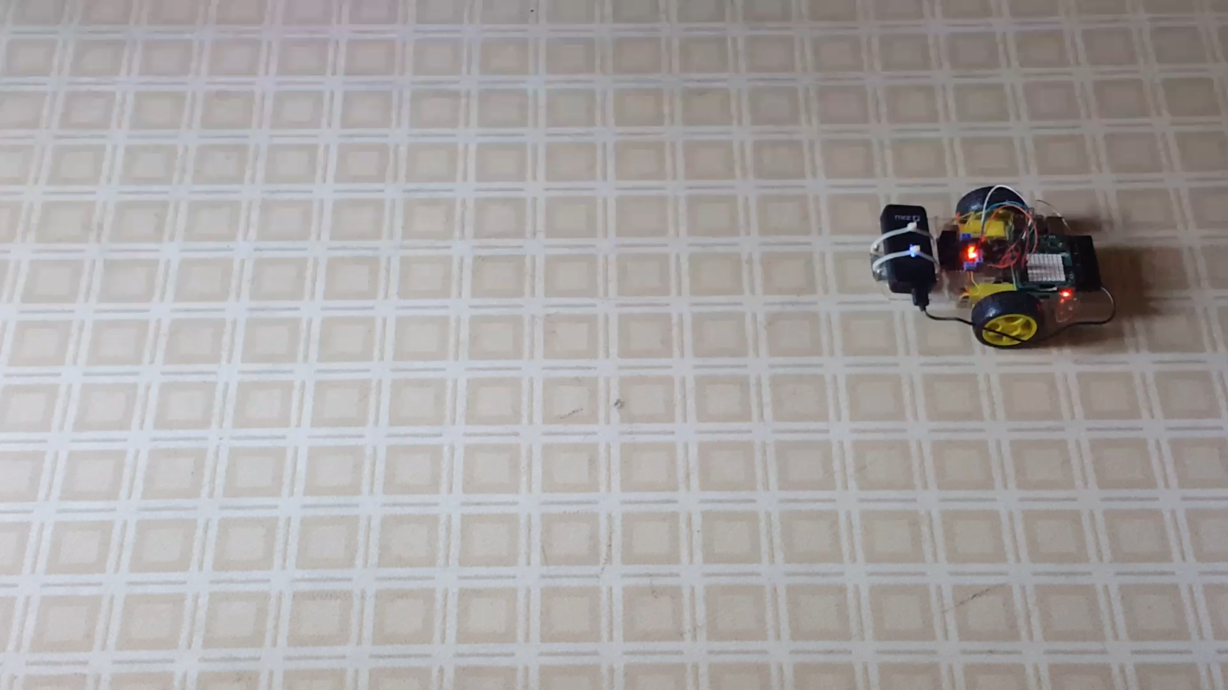
Video Demonstration

Slide 4
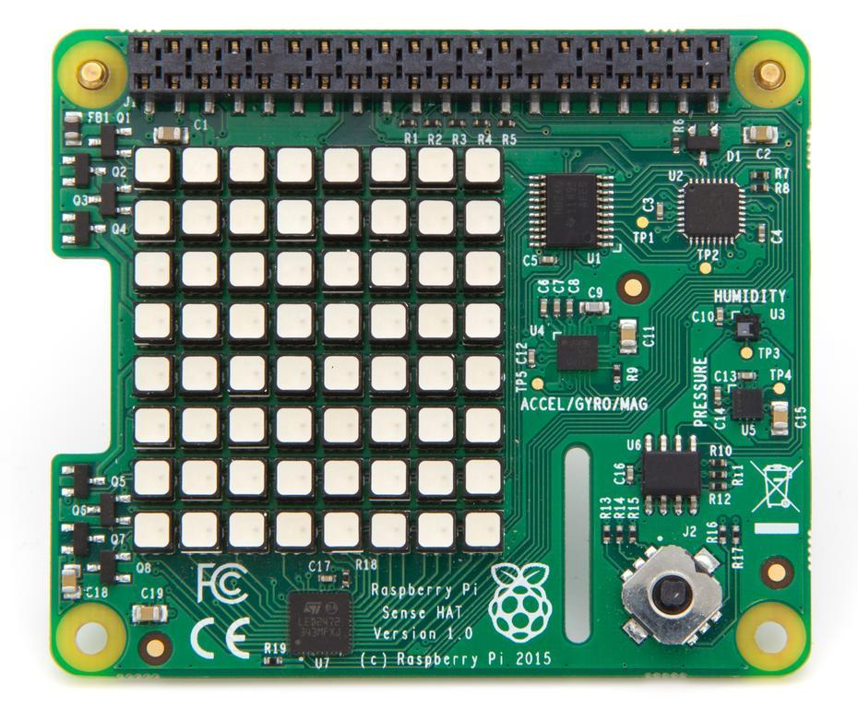
Implementation
Hardware
Software
Raspberry Pi 3 Model B
Sense Hat (Astro Pi add-on board)
Motors, L298N motor driver, power bank, etc.
Raspbian Jessie
Python (Sense Hat/movement)
Kernel modules

Slide 5
Outcomes/Milestones
Past
Future
All milestones met as of progress report
Bot movement
Temperature, humidity, joystick control, display
Issues Faced: linear movement and kernel building research
Controlled test environment
Kernel building
RTOS?
Scheduling optimization (may have up to 4 active tasks at any given time in system)

Slide 6
Task Number | Description | Delivery Date | Met? | Completed By
0 | Submit project proposal | September 25th, 2017 | Yes | Joint
1 | Obtain hardware/software components (shipping) | October 1st, 2017 | Yes | Vahe
2 | Assemble bot components and research necessary hardware components | October 11th, 2017 | Yes | Dan
3 | Set-up Raspberry Pi 3 Model B, configure/install Raspbian OS | October 11th, 2017 | Yes | Dan
4 | Raspberry Pi Sense Hat implementation/interfacing | October 16th, 2017 | Yes | Vahe
5 | Implement sensing module (ex. light sensitivity) | October 18th, 2017 | Yes | Vahe
6 | Start research and modification of Raspbian OS, look at scheduling and task management as it relates to our system, implement simple bot movement | October 25th, 2017 | Yes | Dan
7 | Prepare progress report and sample demo | October 30th, 2017 | Yes | Joint
8 | Implement remaining sensor modules (ex. gyroscope, temperature, etc.) | November 13th, 2017 | - | -
9 | Modify Raspbian OS for maximum optimization of our project and confirm working bot sensing system | November 29th, 2017 | - | -
10 | Test using practical mock environments and collect data | December 6th, 2017 | - | -
11 | Prepare final report and presentation, demo working system with at least 2 unique sensors | December 11th, 2017 | - | -

Slide 7
Thanks For Listening!

